Slide 1
Music Listening Habits During Recessions
Alexander Tuosto

Slide 2
Research Question
How do signals of poor economic conditions affect music listening habits across genres?

Slide 3
Variables
Recession Indicator
Unemployment Rate
Play Share by Genre
Total Plays
Binary Variable 1=Recession, 0=No Recession
NBER, FRED (USREC)
Continuous Variable, Unemployed Relative to Labor Force
BLS, FRED (UNRATE)
PCE Price Index
UMich Consumer Sentiment Survey
Continuous Variable, % change = inflation
BEA, FRED (PCEPI)
Continuous Variable, Index of Consumer Sentiment
University of Michigan, FRED (UMCSENT)
Last.FM API

Slide 4

Last.FM
Music application that pairs with streaming services to track personal listening patterns and recommend new music while also acting as a library for listening data.

Slide 5
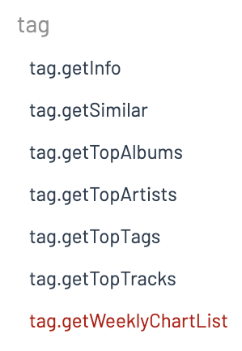
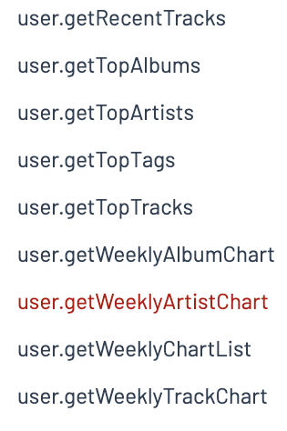
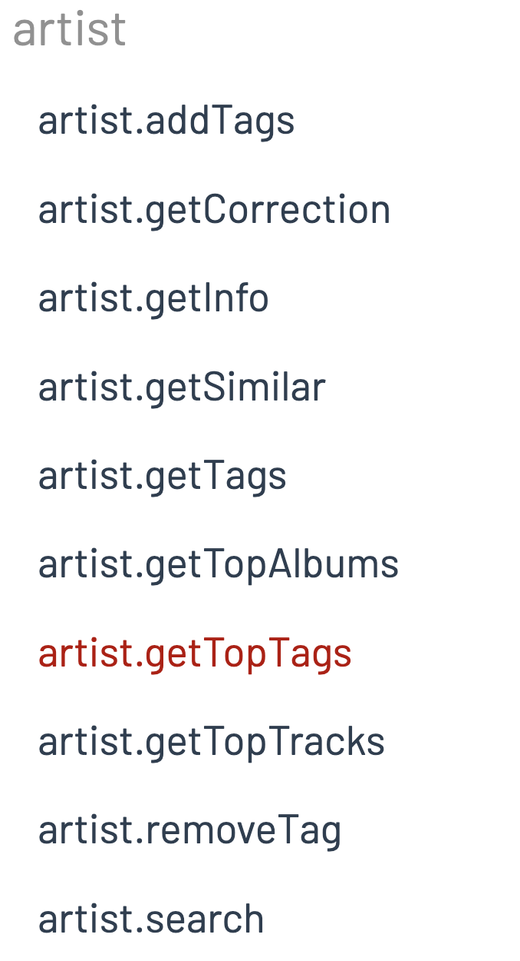
API Documentation
Confusing encoding…
Remedied by consulting their forum and attending office hours
… then straightforward
Each function had a description and an endpoint

Slide 6
API Data Collection
tag.getWeeklyChartList
user.getWeeklyArtistChart
artist.getTopTags
Collected week data (How many weeks am I looking at?)
Collected artist names for every given week.
Got the top tags for each artist

Slide 7
New Variables Created
Play Share by Genre
% of total listening shares per week, expressed as decimal
Total Plays
Measures all plays across all artists in a given week of collection

Slide 8
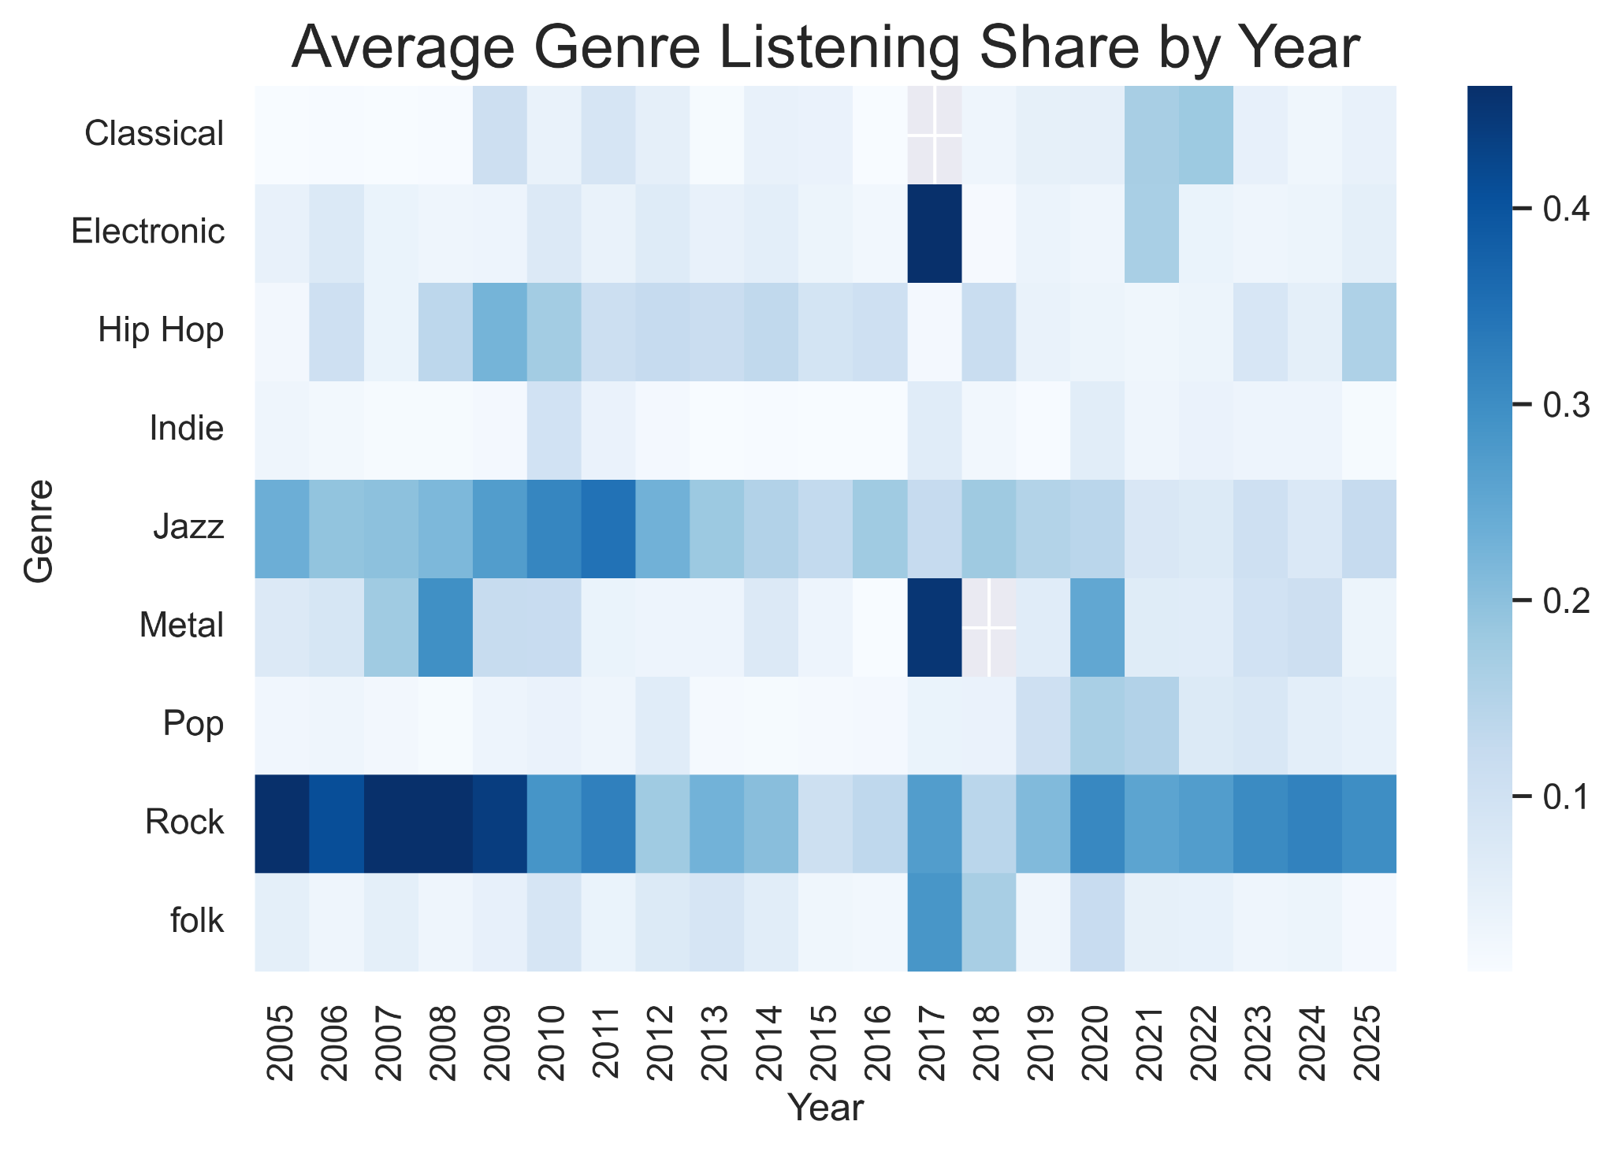
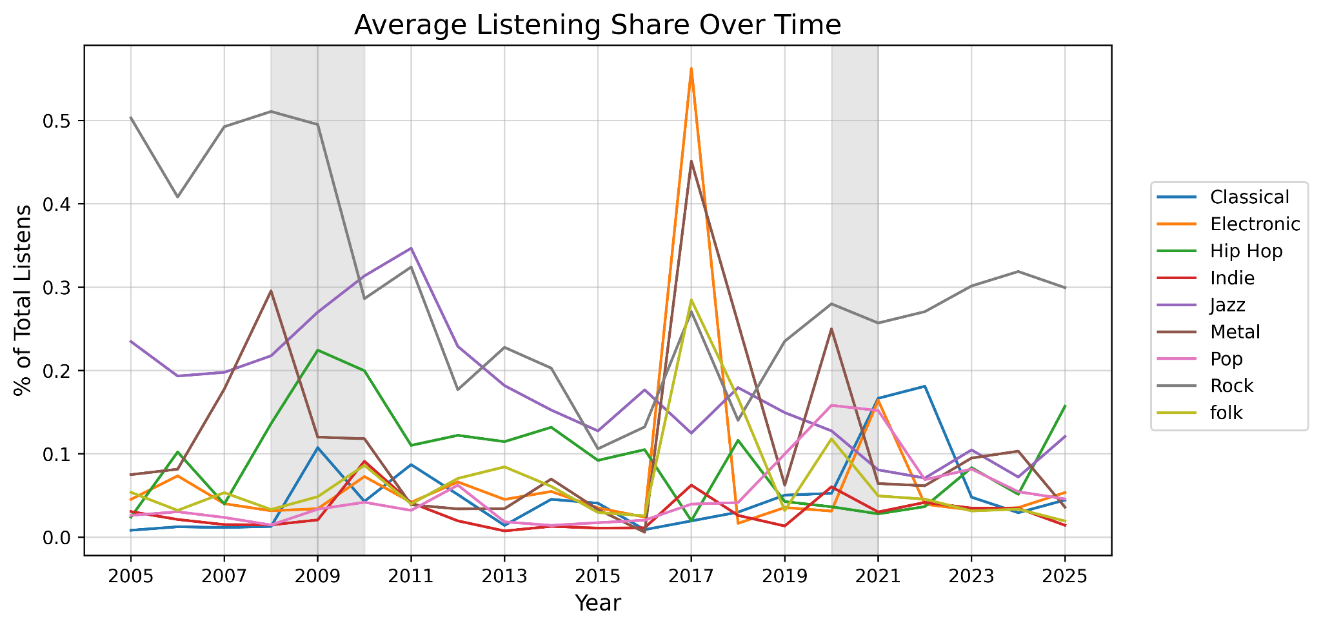
Average Listening Shares by Genre

Slide 9
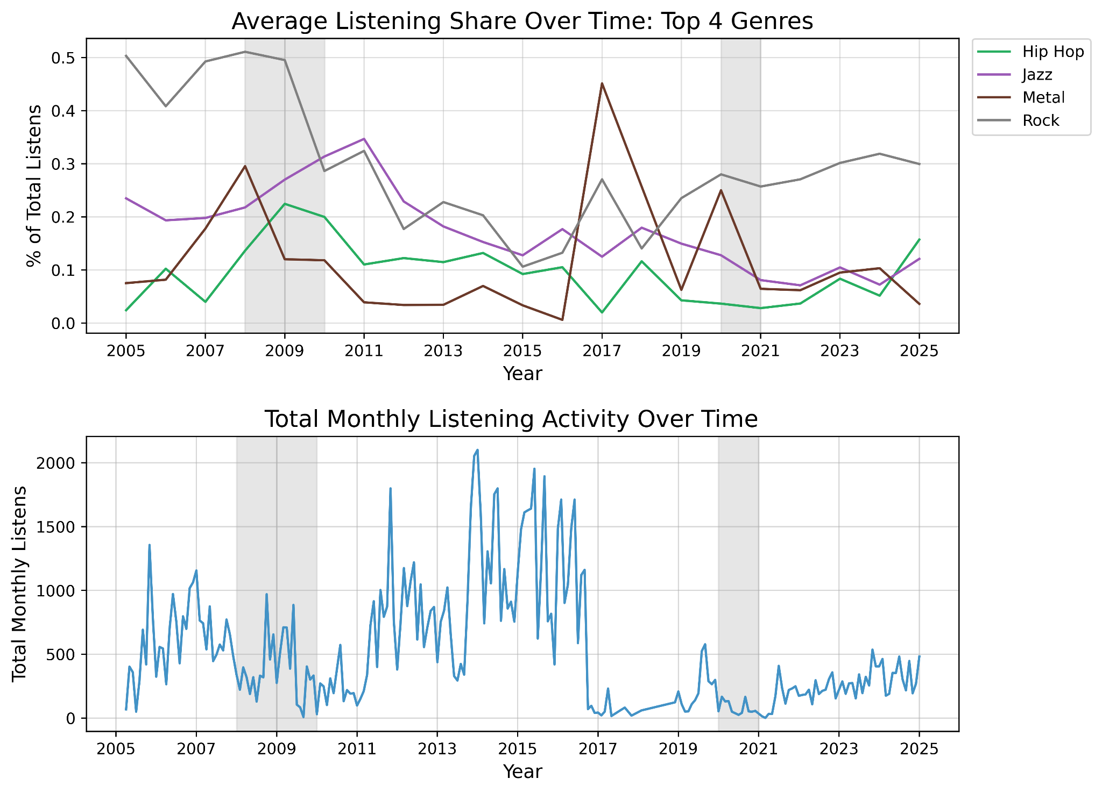
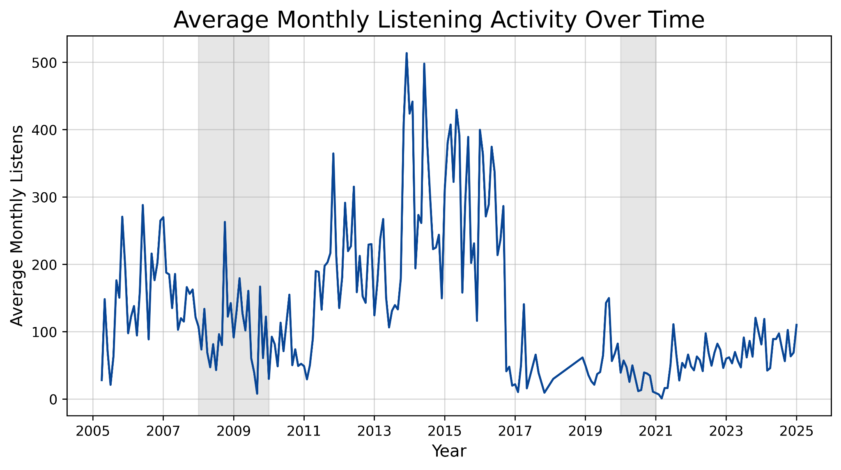
Filtered Graphs

Slide 10
Models
Total Month Plays:
Total.Month.Plays=β0​+β1​(REC)+β2​(UNRATE)+β3​ln(PCE)+β4​ln(UMICH)+ε
Logged Total Month Plays:
ln(Total.Month.Plays)=β0​+β1​(REC)+β2​(UNRATE)+β3​ln(PCE)+β4​ln(UMICH)+ε
Logged Genre Play Share:
ln(Play.Share_{i}​)=β0​+β1​(REC)+β2​(UNRATE)+β3​ln(Total.Plays)+β4​ln(PCE)+β5​ln(UMICH)+ε
*i is an individual genre

Slide 11
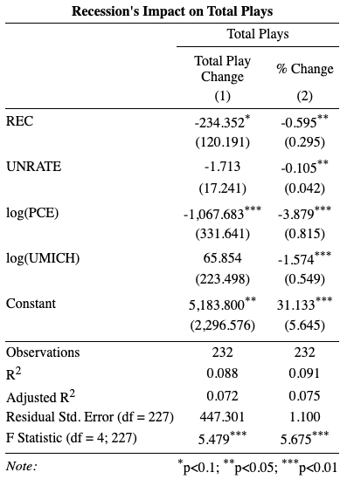
Total Plays Regression
Findings
Recessions do cause a decrease in listening (nearly 60%)
Unemployment has little impact in play change, larger in % change
Inflation has a very dramatic effect on listening habits
UMich Survey is only significant when it is logged

Slide 12
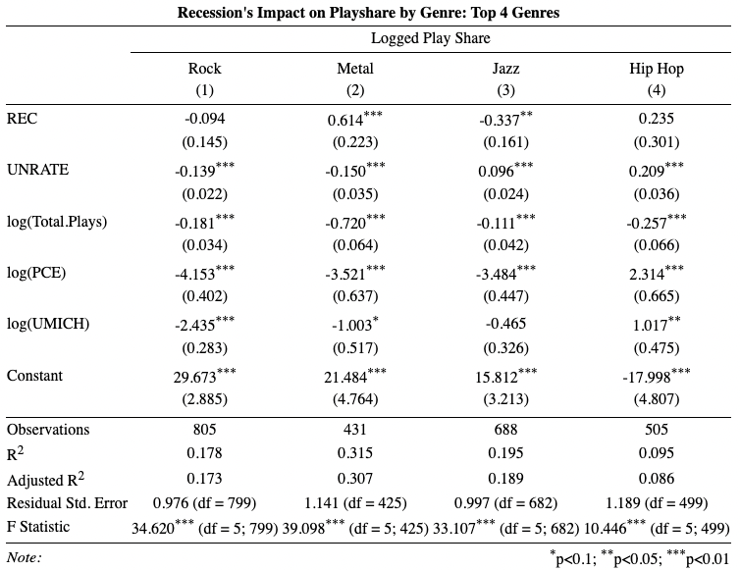
Genre Regressions: Top 4
Metal and Hip Hop experience increases in play share during recessions
1 PP increase in Unemployment decreases Rock and Metal, increases Jazz and Hip Hop
As total plays increase, genres get more diverse
Inflation again is very dramatic, except for Hip Hop
UMich decreases all except for Hip Hop

Slide 13
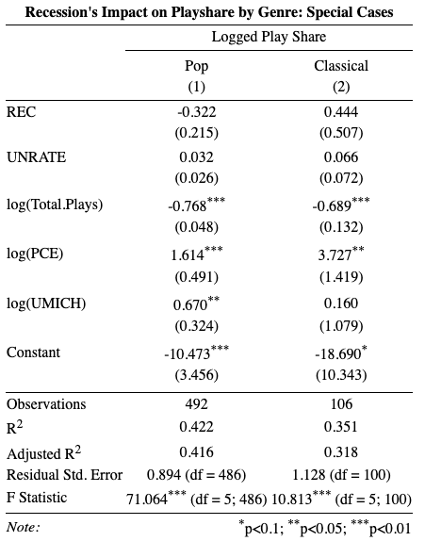
Genre Regressions: Special Cases
Recession Pop does not exist for these models, Recession Classical does, however
Unemployment Rate does not change shares
Total Plays follows the same trend as other genres
Inflation increases playshare
More pop when sentiment increases, possibly more classical

Slide 14
Future Improvements
Use actual global data not one person
Take into account song content
Control for mood (happy vs sad rock)
Control for keywords
Find different method to get genres
User generated tags, not homogenous
Use Fixed Effects to control for more popular genres
‘Classic Rock’ is going to have a different listen count than PBR&B or Shoegaze, larger more macro genre

Slide 15
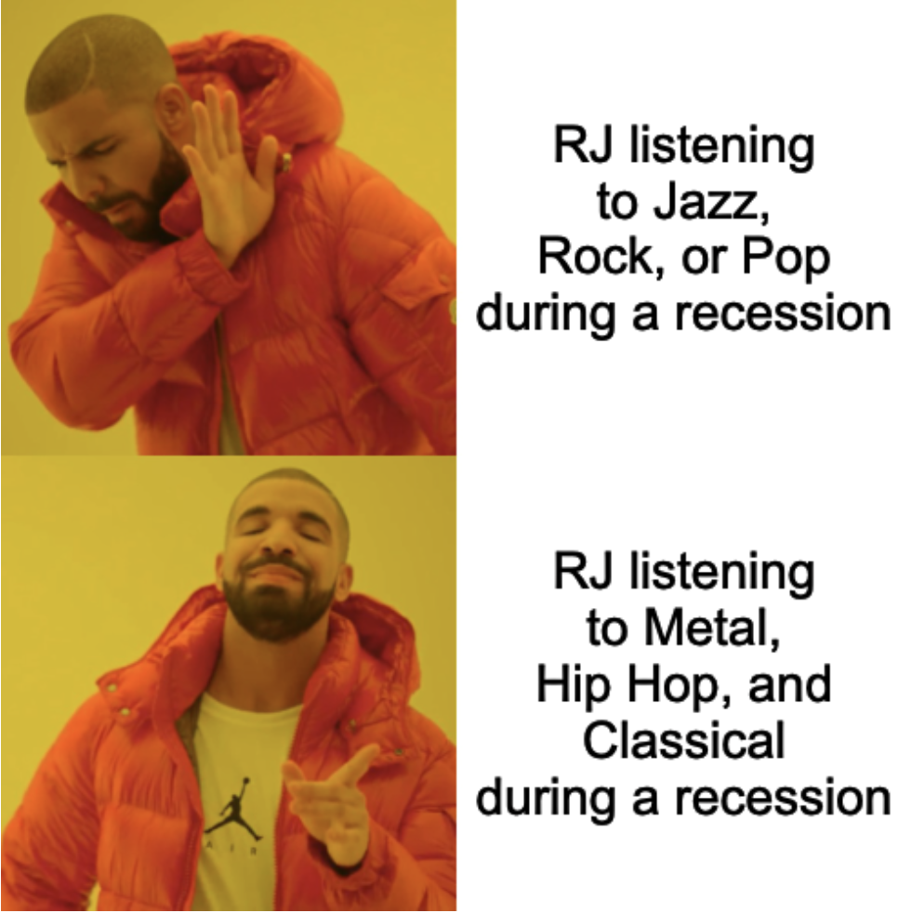
Thank you!

